Slide 1
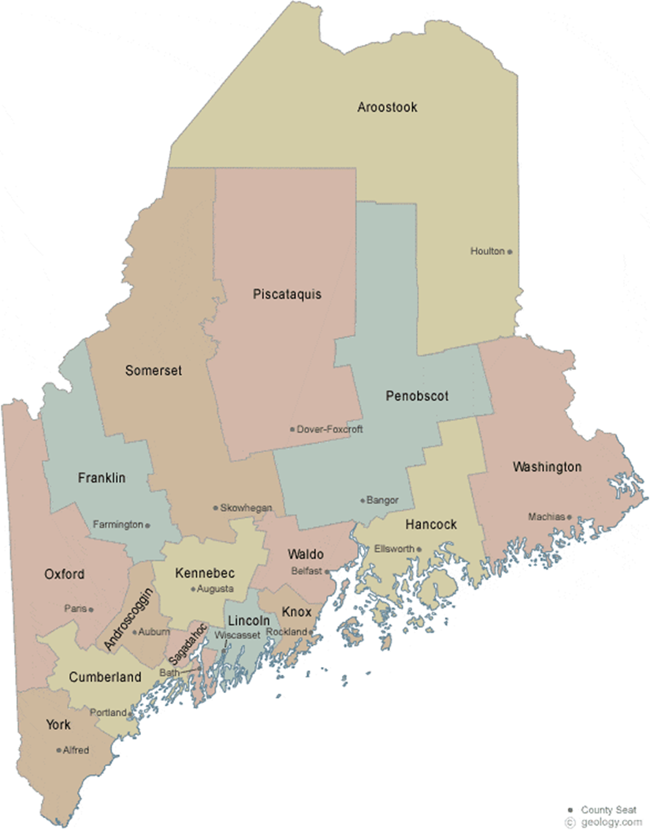
Welcome back!
Use draw tools to show us where you are on the map!
Also, share a tradition or a fun fact about yourself in the chat box!

